Slide 1
Software Engineering
Sobia Iftikhar
Sobia.Iftikhar@nu.edu.pk
Week 08

Slide 2
Class 19 31-March-2021

Slide 3
Content
Architectural design decisions
Architectural views
Architectural patterns
Application architectures

Slide 4

Architecture vs Design
There is a distinct difference between the terms architecture and design.
A design is an instance of an architecture similar to an object being an instance of a class.
For example, consider the client-server architecture. I can design a network-centric software system in many different ways from this architecture using either the Java platform (Java EE) or Microsoft platform (.NET framework). So, there is one architecture, but many designs can be created based on that architecture. Therefore, you cannot mix “architecture” and “design” with each other

Slide 5
Architectural design
Architectural design is concerned with understanding how a software system should be organized and designing the overall structure of that system.
The architectural design starts then the developed software is put into the context.
The information is obtained from the requirement model and other information collect during the requirement engineering.

Slide 6
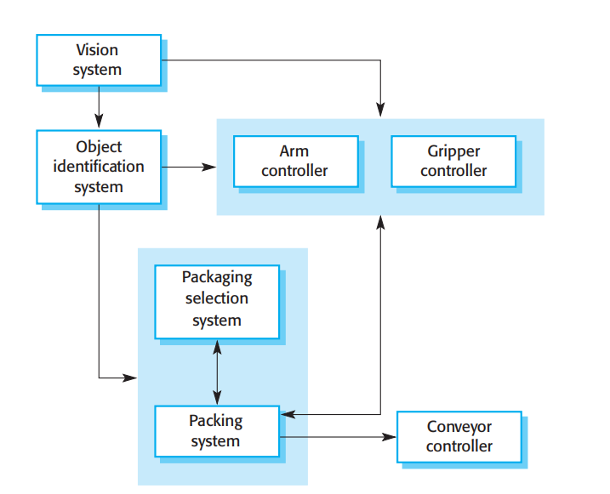
Architecture Design

Slide 7
Agility and architecture
It is generally accepted that an early stage of agile processes is to design an overall systems architecture.
Refactoring the system architecture is usually expensive because it affects so many components in the system

Slide 8
Architecture level of abstraction
Architecture in the small is concerned with the architecture of individual programs. At this level, we are concerned with the way that an individual program is decomposed into components. This chapter is mostly concerned with program architectures.
Architecture in the large is concerned with the architecture of complex enterprise systems that include other systems, programs, and program components. These enterprise systems may be distributed over different computers, which may be owned and managed by different companies.

Slide 9
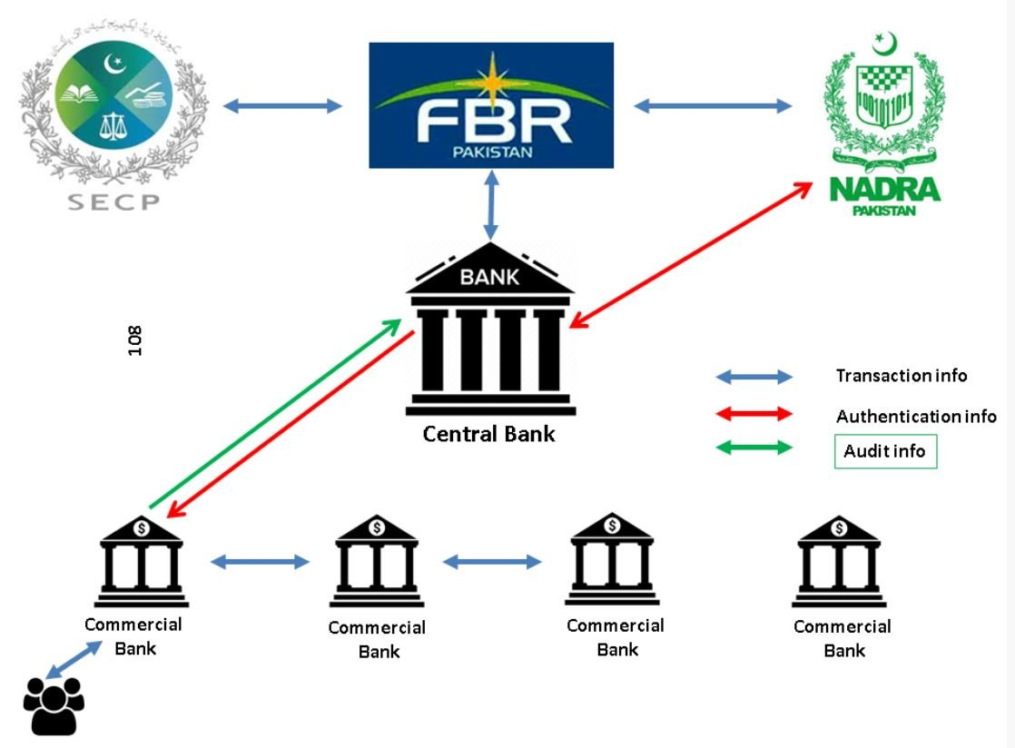
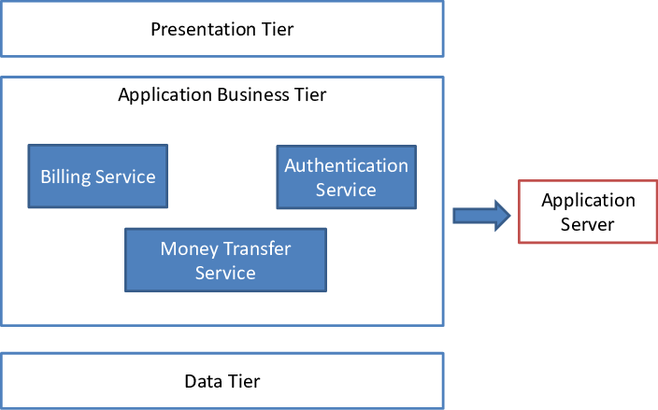
Architecture level of abstraction

Slide 10

Advantages of explicit architecture
Stakeholder communication
Architecture may be used as a focus of discussion by system stakeholders.
System analysis
Means that analysis of whether the system can meet its non-functional requirements is possible.
Large-scale reuse
The architecture may be reusable across a range of systems
Product-line architectures may be developed.
“architecturally significant requirements” where they found that non-functional requirements had the most significant effect on the system’s architecture.
Bass et al. (suggest that explicitly designing and documenting software architecture has three advantages):

Slide 11
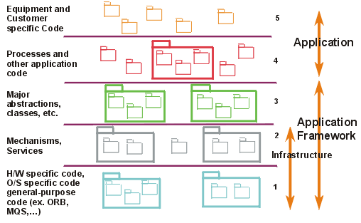
Architectural representations
Block diagrams present a high-level picture of the system structure
Each box in the diagram represents a component. Boxes within boxes indicate that the component has been decomposed to subcomponents. Arrows mean that data and or control signals are passed from component to component in the direction of the arrows

Slide 12
Class 20 01-March-2021

Slide 13
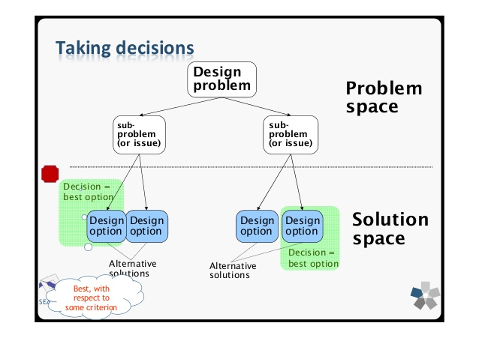
Architectural design decisions
Architectural design is a creative process so the process differs depending on the type of system being developed.
However, a number of common decisions span all design processes and these decisions affect the non-functional characteristics of the system.

Slide 14
Architectural design decisions

Slide 15
Architecture and system characteristics Quality Attributes
Performance
Localise critical operations and minimise communications. Use large rather than fine-grain components.
Security
Use a layered architecture with critical assets in the inner layers.
Safety
Localise safety-critical features in a small number of sub-systems.
Availability
Include redundant components and mechanisms for fault tolerance.
Maintainability
Use fine-grain, replaceable components.

Slide 16
Architectural views
What views or perspectives are useful when designing and documenting a system’s architecture?
What notations should be used for describing architectural models?
It is impossible to represent all relevant information about a system’s architecture in a single diagram, as a graphical model can only show one view or perspective of the system. ?
for both design and documentation, you usually need to present multiple views of the software architecture.
There are different opinions as to what views are required. Krutchen (Krutchen 1995) in his well-known 4 +1 view model of software architecture

Slide 17
Architectural views

Slide 18
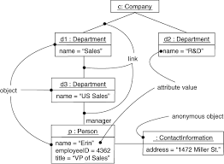
Logical View
Logical view focus on functional requirement
Show the key abstraction in system as object or object.
Describes how the system is structured in terms of units of implementation. The elements are packages, classes, and interfaces.
Viewer : Ender User
The relationship between elements shows dependencies, interface realizations, part-whole relationships, and so forth.
Class Diagram
Sequence Diagram
Communication Diagram

Slide 19
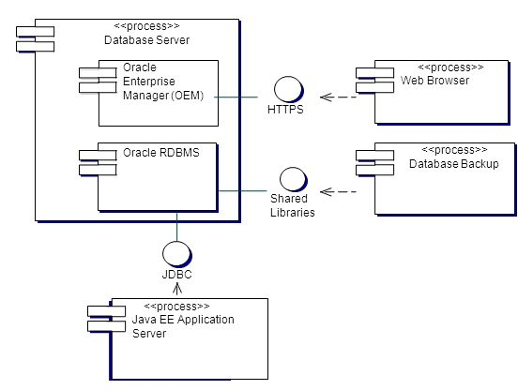
Process View
How system is run
Focus on achieving no-functional requirement
which shows how, at runtime, the system is composed of interacting processes. This view is useful for making judgments about non-functional system characteristics such as performance and availability.
Viewer: integrated

Slide 20
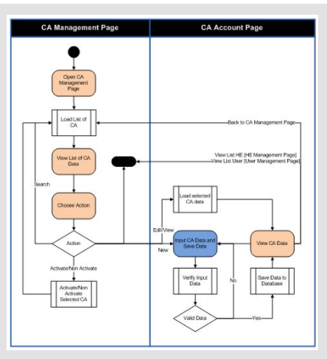
Process View

Slide 21
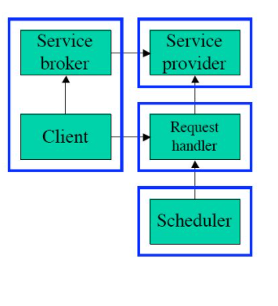
A development view
It shows the decomposition of the system into different modules that will be implemented by different development teams and also represents the logical organization of the code.

Slide 22
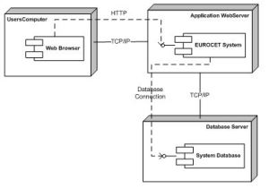
Implementation view
Physical view is used for depicting how the software is deployed in data centers.
For example in case of web based application you will show which web service you have used, no of servers and their role, and the software components installed on them. This view is useful for System engineers. The view below shows that two servers a database server and a web application server will be used in this EUROCET system.

Slide 23
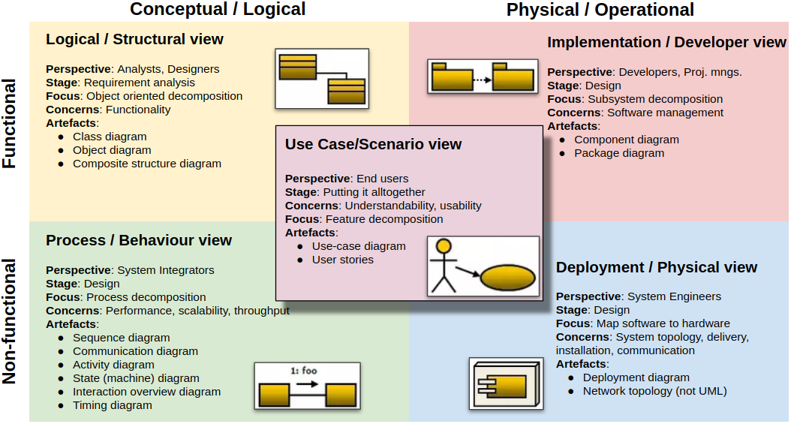
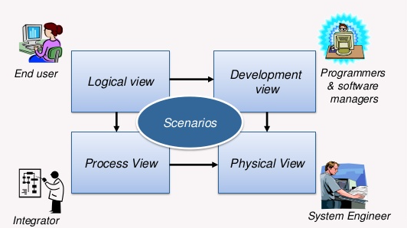

Slide 24
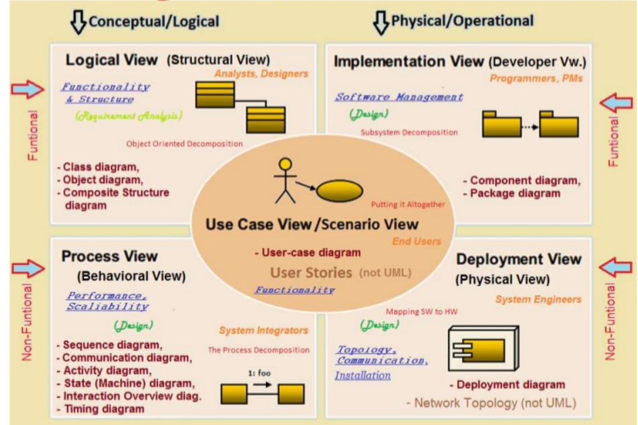
Summary

Slide 25
Architecture Pattern and Design Pattern
Software architecture is responsible for the skeleton and the high-level infrastructure of software,
whereas software design is responsible for the code level design such as, what each module is doing, the classes scope, and the functions purposes, etc.
Generally, the architecture and design both explains the idea but architecture focus on the abstract view of idea while design focus on the implementation view of idea.

Slide 26
Design Patterns:
It solves reoccurring problems in the software Design.
Creational Patterns: It focus on how to instantiate an object or group of related objects.
Abstract Factory
Builder
Factory Method
Prototype
Singleton pattern
Structural Patterns: Identifying a simple way to realize relationships among Entities.
Adapter
Bridge
Decorator
Facade
Proxy pattern
Behavioral Patterns: It identify common communication patterns between objects and realize these patterns.
Command
Interpreter
Iterator
Mediator
Null Object
Observer

Slide 27
Architectural Pattern
Patterns are a means of representing, sharing and reusing knowledge. An architectural pattern is a stylized description of a good design practice, which has been tried and tested in different environments.
Patterns should include information about when they are and when the are not useful. Patterns may be represented using tabular and graphical descriptions.
Patterns help you build on the collective experience of skilled software engineers.

Slide 28
The architectural patterns address various issues such as :
Performance
High availability
Scalability
Security
Maintainability
Testing
Deployment
Technology Stack

Slide 29
#Examples:
MVC Pattern
Model View Presenter (MVP)
Layered pattern (N-tier Architecture)
Master-Slave Pattern
REST (Architecture Style)
Monolithic architecture
Micro service architecture
Event-driven architecture (EDA)
Service-Oriented architecture (SOA)

Slide 30
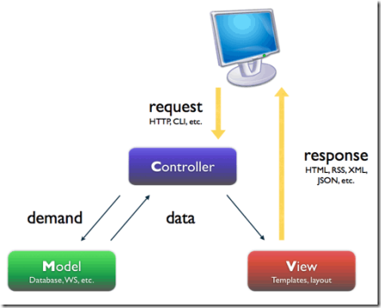
MVC

Slide 31
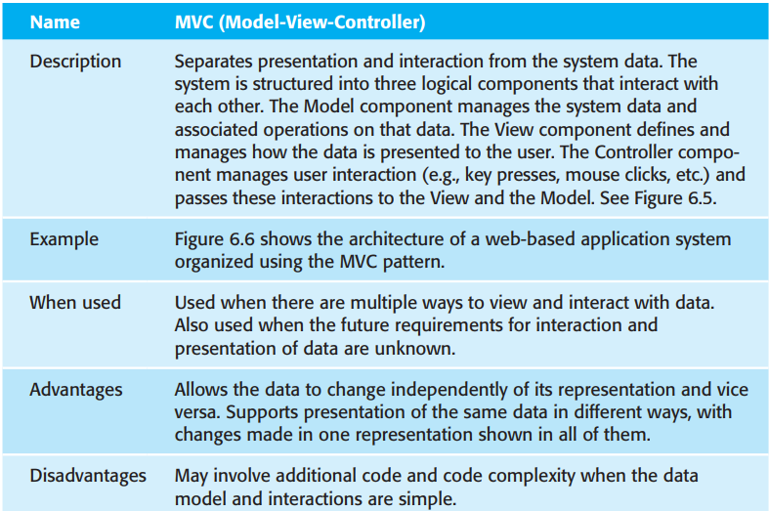
The Model-View-Controller (MVC) pattern
Patterns may be described in a standard way using a mixture of narrative description and diagrams.
Architectural pattern should describe a system organization that has been successful in previous systems. It should include information on when it is and is not appropriate to use that pattern, and details on the pattern’s strengths and weaknesses.

Slide 32
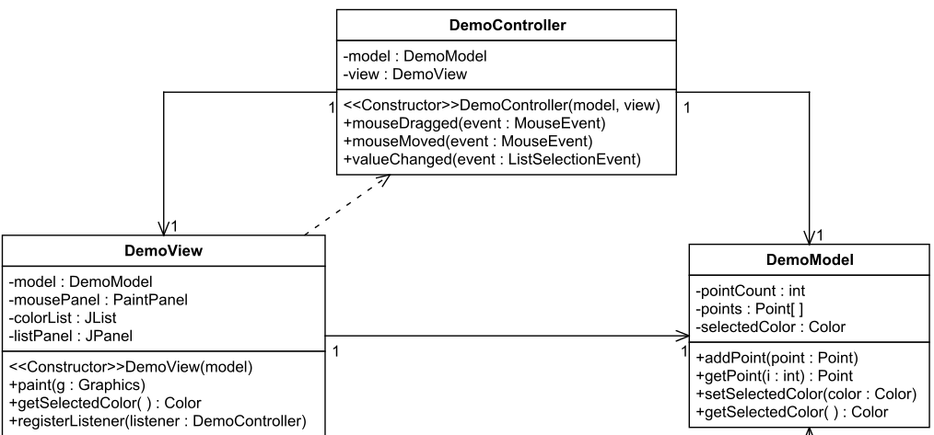
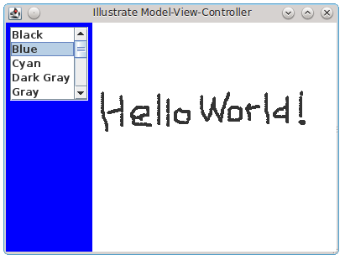
Demo Example
A DemoModel object has instance variables for storing an array of Points and a color.
2. DemoController implements the MouseMotionListener interface (mouseDragged and mouseMoved method) and the ListSelectionListener interface (valueChanged method).
3. DemoView is a subclass of JFrame.

Slide 33
Layered architecture patterns
Layered architecture patterns are n-tiered patterns where the components are organized in horizontal layers.
This is the traditional method for designing most software and is meant to be self-independent.
separates elements of a system, allowing them to change independently.
For example, adding a new view or changing an existing view can be done without any changes to the underlying data in the model.
This layered approach supports the incremental development of systems. As a layer is developed, some of the services provided by that layer may be made available to users

Slide 34
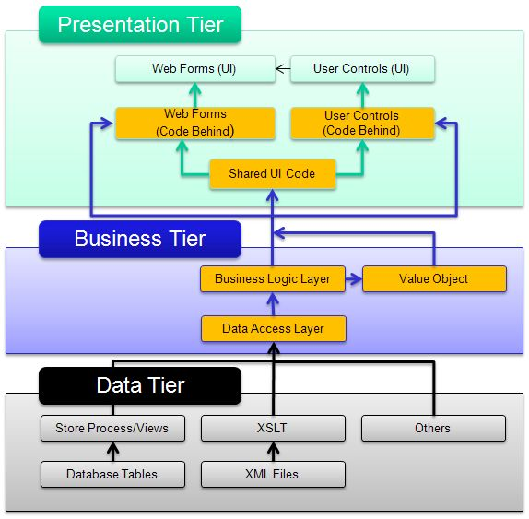
The four standard layers are described as follows.
Presentation Layer This layer contains all user interfaces exposed to a user. It may provide different types of user interfaces, namely web, desktop and native mobile applications.
Business Logic Layer This layer handles all business logic, validations and business processes.
Data Access Layer This layer is responsible for interacting with a database. It is also known as the persistence layer.
Data Store Layer This layer is the actual data store for the application.

Slide 35
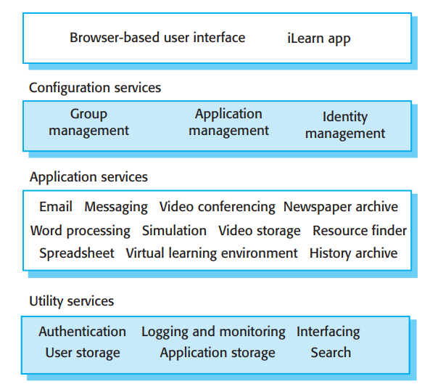
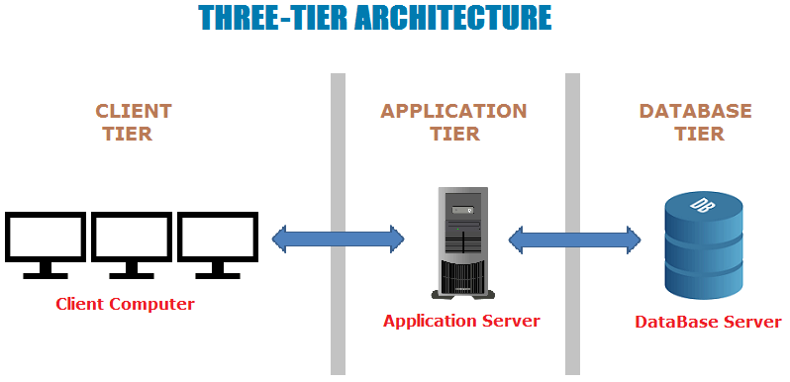
The architecture of the iLearn system
https://www.ecanarys.com/Blogs/ArticleID/76/3-Layered-Architecture

Slide 36
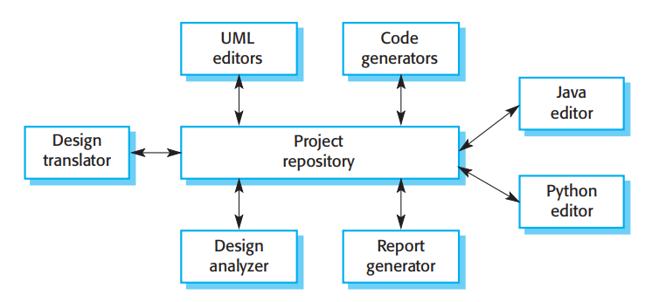
Repository architecture
A data store will reside at the center of this architecture and is accessed frequently by the other components that update, add, delete or modify the data present within the store.
This model is therefore suited to applications in which data is generated by one component and used by another.

Slide 37
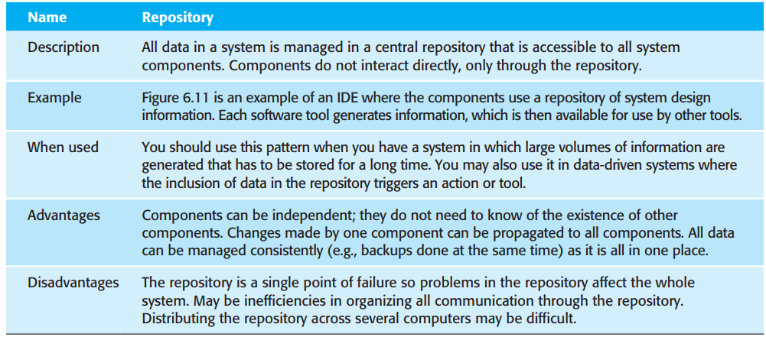
Repository architecture

Slide 38
Client–server architecture
Client-server architecture is a computing model in which the server hosts, delivers and manages most of the resources and services to be consumed by the client. This type of
architecture has one or more client computers connected to a central server over a network or
internet connection. Client-server architecture is also known as a networking computing
model or client-server network because all the requests and services are delivered over a
network.

Slide 39
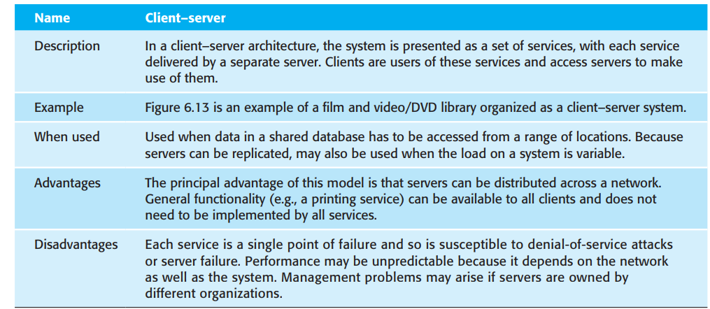
Client–server architecture

Slide 40
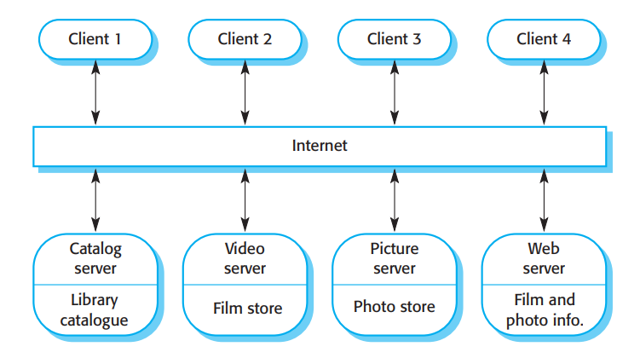
Example

Slide 41
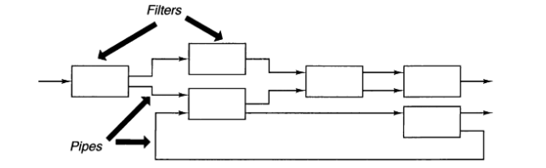
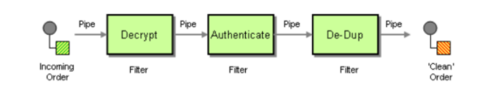
Pipe and filter architecture
This is a model of the runtime organization of a system where functional transformations process their inputs and produce outputs.
pipe and Filter is a simple architectural style that connects a number of components that process a stream of data, each connected to the next component in the processing pipeline via a Pipe.

Slide 42
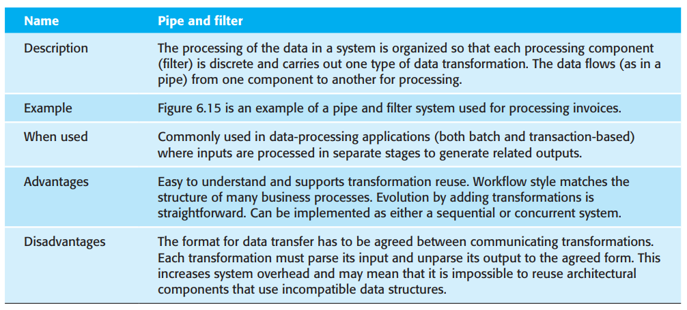
Pipe and filter pattern

